Slide 1
Introduction to RStudio IDE
Coffee & Coding @ the DHSC
10/06/2021

Slide 2
Content
Part – Introduction
Part – Basics
Part - Advancing Further

Slide 3
Part I – Introduction

Slide 4
What’s an IDE?
An integrated development environment (IDE) is a software application that provides comprehensive facilities to computer programmers for software development
Examples of IDE’s for R language:
Rstudio
Visual Studio Code (https://marketplace.visualstudio.com/items?itemName=Ikuyadeu.r)
Vim (https://github.com/jalvesaq/Nvim-R)
RKWard
IDE ≠ GUI (Graphical User Interface)

Slide 5
Builds/Platforms
RStudio versions (builds) – stable, preview, daily
Platforms
RStudio Desktop: Open Source Edition / Pro Edition
RStudio Server (Cloud): Open Source Edition / RStudio Workbench (Pro)

Slide 6
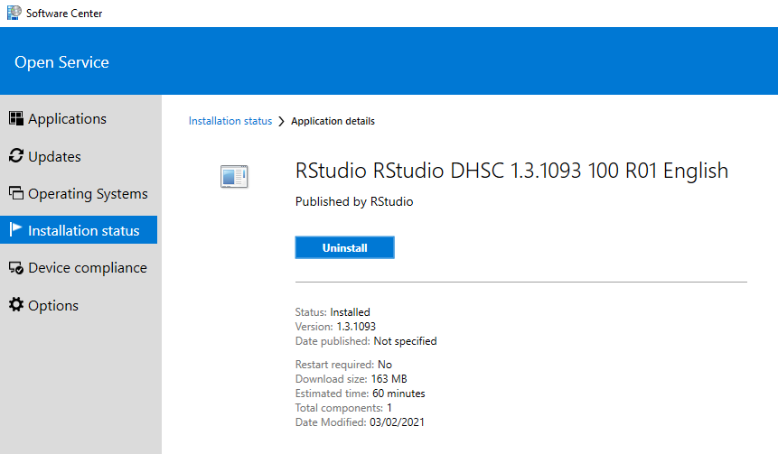
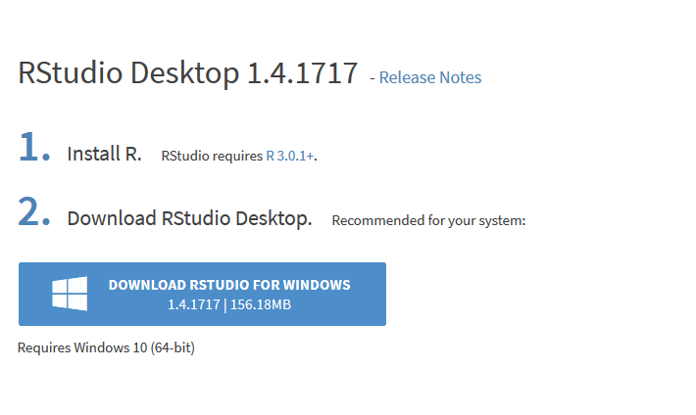
Installation & Overview
Non-Admin “path”
Admin “path” aka a Developer Account

Slide 7
Part II – Basics

Slide 8
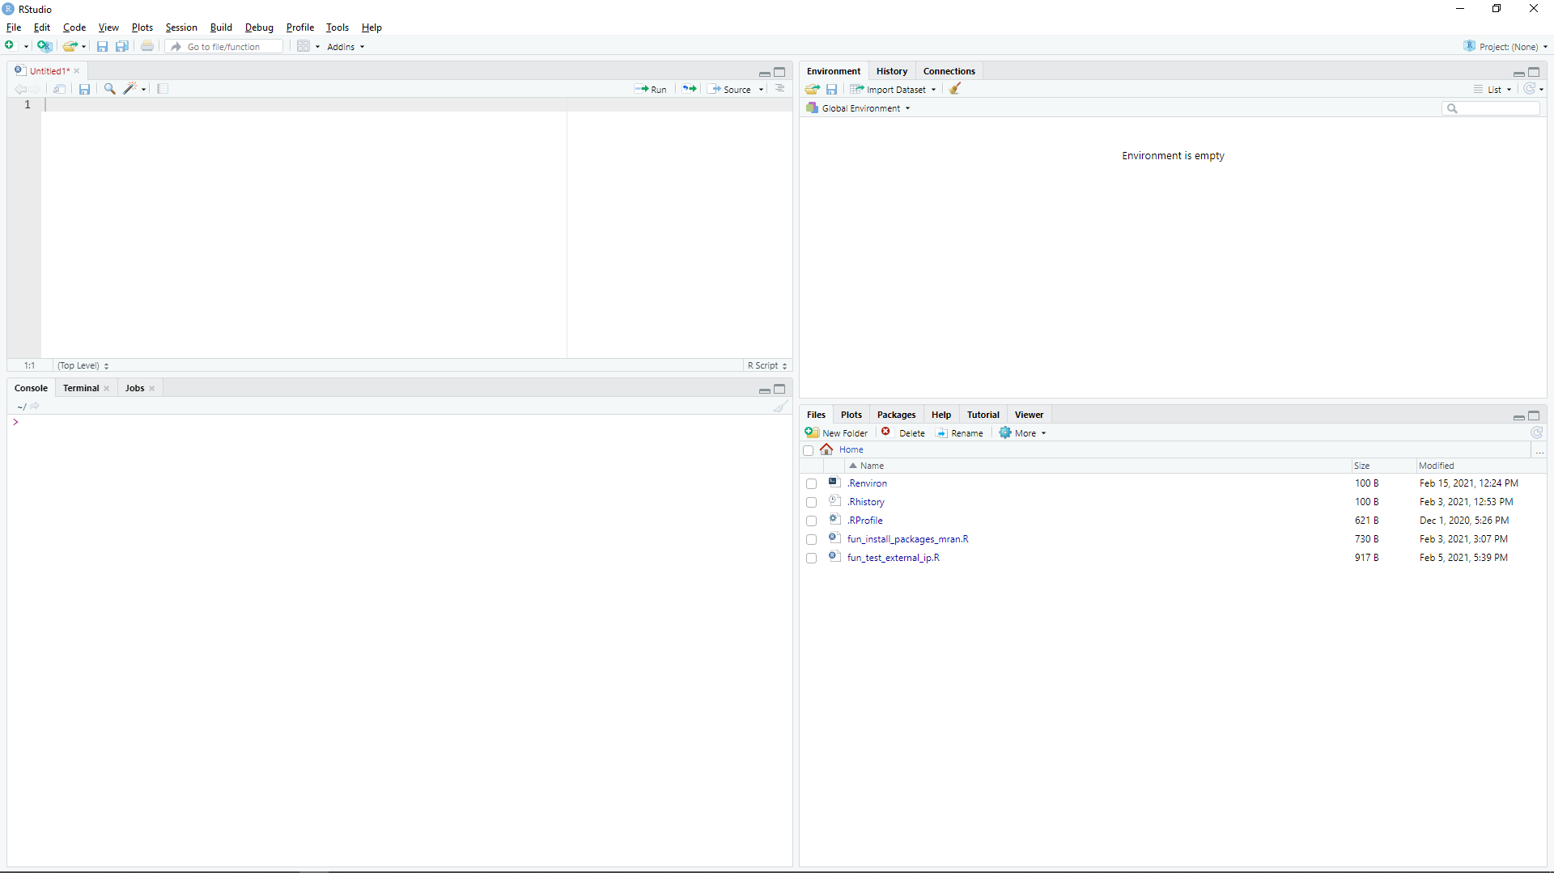
Part II - Basics
I will cover the following topics:
Going through core functionality of the IDE
Explaining projects
Introducing panes and basic features
Global options
Each will be presented interactively in RStudio IDE.

Slide 9
RStudio Basics & Projects
RStudio layout features 4 customisable quadrants
Creating RStudio project files (.Rproj)
Managing projects from within RStudio (creating files / folders)
Opening from .Rproj (different ways)
Creating and running scripts
Sourcing scripts
Introducing the rest of the panes
+ and - of RStudio projects

Slide 10
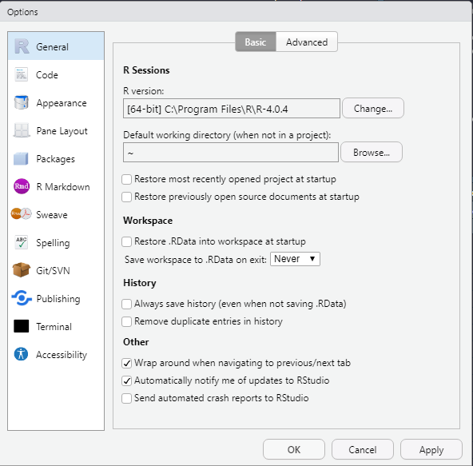
Setting Global Options
General - Default CRAN mirror, initial working directory, workspace and history behaviour.
Code - Enable/disable line numbers, selected word and line highlighting, soft-wrapping for R files, parenthesis matching, right margin display, and console syntax highlighting; configure tab spacing; set default text encoding.
Appearance - Specify font size and visual theme for the console and source editor.
Panes - Locations of console, source editor, and tab panes; set which tabs are included in each pane.
Packages - Set default CRAN repository and specify package development options.
R Markdown - Reporting options for Markdown.
Sweave - Configure Sweave compiling options and PDF previewing.
Spelling - Choose main dictionary language and specify spell checking options.
Git - Configure locations of Git and SVN binaries and create and/or view SSH RSA keys.
Publishing - Enable publishing apps and documents from IDE. Set account.
Terminal - Configuring command line.
Accessibility - Making use of the assistive tools available in RStudio.
More information available here.

Slide 11
Part III – Advancing Further

Slide 12
Tips & Trics
CTRL + ENTER
Changing Version of R while opening RStudio
Autocompletion:
Fuzzy matching, skipping letter
File search
Code snippets (e.g., fun, shift + tab)
Command history (CTRL+UP)
Find Files/Functions (CTRL+.)
Find Files (CTRL + SHIFT + F)
File -> Close All
Keyboard Shortcuts (Shift + Alt + K)
For more, follow @rstudiotips

Slide 13
Extending RStudio with Add-ins
Powerful extensions expanding core functionality of RStudio
Keep the core of the IDE clean (i.e., no visual clutter)
Easy to install
Written in R (part of R packages)
Examples:
Installing Add-ins
Using
Binding
https://github.com/daattali/addinslist

Slide 14
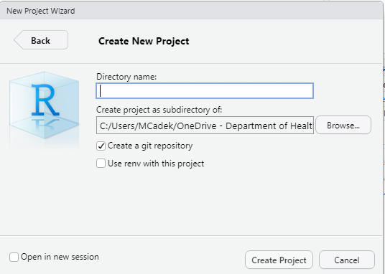
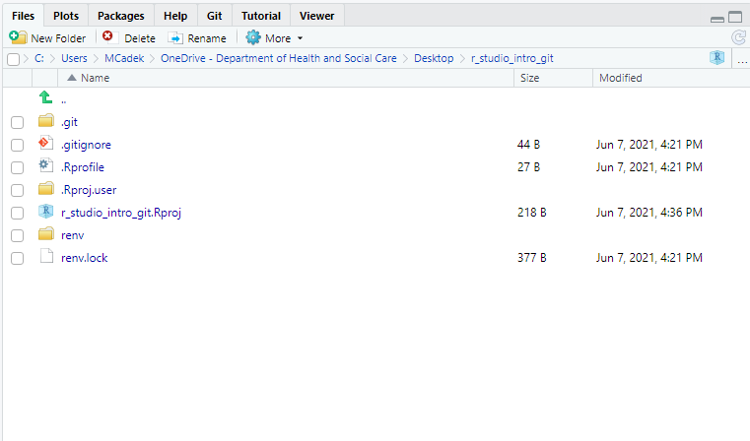
GIT Projects

Slide 15
R Markdown Projects
Markdown is a simple formatting syntax for authoring HTML, PDF, and MS Word documents.
It is a simple "text" file and can be tracked on Git, modified outside proprietary software.
For more details on using R Markdown see:
http://rmarkdown.rstudio.com
https://m-clark.github.io/Introduction-to-Rmarkdown/introduction.html

Slide 16
Notebook Projects
Similar to RMarkdown but can Preview files, but offers:
Real-time previews (e.g. equations)
Handles more than one output (gallery views)
Can handle multiple languages (e.g. SQL, Python)
html_notebook output type (preview note: unlike knitting it does note re-run the code)
Otherwise a plain text file

Slide 17
There’s more
Presentations Projects (like this one :) )
Shiny Projects
Package development
Documentation
SQL, Python, D3 scripts
and more...

Slide 18
References / Resources
https://www.youtube.com/watch?v=kuSQgswZdr8
https://github.com/rstudio/cheatsheets/raw/master/rstudio-ide.pdf
https://rladiessydney.org/courses/ryouwithme/01-basicbasics-1/
https://bookdown.org/yihui/rmarkdown/
https://support.rstudio.com/hc/en-us/articles/200549016-Customizing-RStudio

Slide 19
Thank you!

